Slide 1
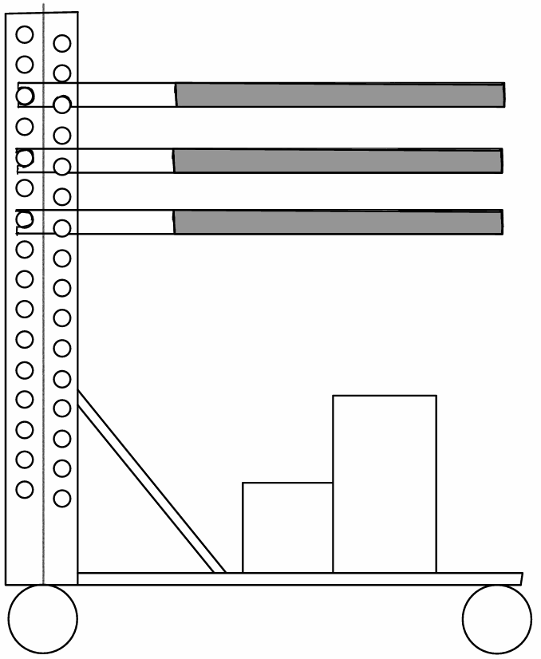
Scintillators
FPGA
+Comparators
+V-vias generators

Slide 2

Triggered Output To DAQ
SiPM + PCB
Zoomed in SiPM
Comparator Boards
FPGA Board
V-Bias Programmable Port
RJ45 Cable
Comparator Boards
6.48V
0.09A
5.00V
0.26A
V-bias board
Comparator Boards
Power Supply
To Computer

